Slide 1
CORE COURSE - 5: (L1-1) Language, Variety and Stylistics
JAYANTO GHOSH
ASST. PROFESSOR
S R S VIDYAMAHAPITHA

Slide 2
ONLY FOR Arts & Commerce General students

Slide 3
Marks Division
10 x 2 = 20
5 x 4 = 20
2 x 10 = 20
________________
Total = 60

Slide 4
Syllabus:
Language & Communication – distinctness of human language
Language varieties – Standard & Non-standard Language, Formal & Informal
Difference between Declarative and Expressive forms of language – when Statement becomes Expression
Register, Collocation and Style

Slide 5
What is language?
A system for the communication, in symbols, of any kind of information.
Through language, people share their experiences, concerns, and beliefs and communicate these to the next generation.

Slide 6
Distinctness of Human Language
Language is verbal, vocal
Language is a means of communication
Language is a social phenomenon
Language is arbitrary.
Language is unique, creative, complex and modifiable.
Language is systematic.
Language is symbolic.
Language is both linguistic and communicative competence.

Slide 7
What is communication?
Communication (from Latin commūnicāre, meaning "to share") is the act of conveying intended meanings from one entity or group to another through the use of mutually understood signs and semiotic rules.

Slide 8
Different Types of Communication
Verbal Communication
written communication
Non-verbal Communication

Slide 9
Verbal-Communication - The sharing of information between individuals by using speech.
Written-Communication - Written communication involves any type of interaction that makes use of the written word.

Slide 10
Non-verbal Communication
Non verbal communication is a very wide concept and it includes all the other forms of communication which do not uses written or spoken words.

Slide 11
Non verbal communication takes following forms:
Paralinguistics: other than actual language and involves tones, pitch, vocal cues etc
Artifactics : personal accessories such as dresses or fashion
Chronemics: pauses, silences and response lag during an interaction.

Slide 12
Cont.
Kinesics:
Body Language
Eye Contact
Touch
Posture
Facial Expressions

Slide 13
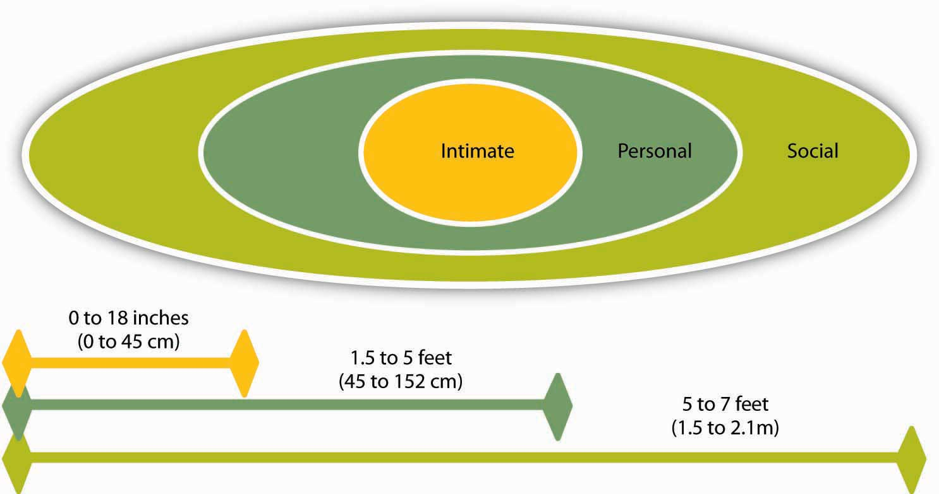
Proxemics: Anthropologist Edward T. Hall coined the term proxemics to denote the different kinds of distance that occur between people. These distances vary between cultures.

Slide 14
CHAPTER II: What is standard language?
A standard language is a variety of language that is used by governments, in the media, in schools and for international communication.

Slide 15
Features of Standard language
An authoritative dictionary which records the vocabulary of the language
An authoritative grammar which records the forms, rules and structures of the language
A recognized standard of pronunciation;
Mention of the language in legal documents
The use of the language throughout public life
(for example in a country’s parliament) and its formal instruction in schools;
A body of literary texts
Formal instruction of and research into the language and its literature in institutions of higher education
An institution promoting the use of the language and its formal instruction in educational institutions abroad
Translations of key religious texts such as the Bible or the Koran.

Slide 16
Nonstandard language
A nonstandard language is a dialect that does not have the institutional support or sanction that a standard dialect has. Like any dialect, a nonstandard dialect has its own vocabulary and an internally consistent grammar and syntax; and it may be spoken using one or a variety of accents.

Slide 17
Formal and Informal language
We use formal language in situations that are serious or that involve people we don’t know well.
Formal language is more common when we write
Informal language is more commonly used in situations that are more relaxed and involve people we know well.
Informal language is more common when we speak.

Slide 18
Examples:
Informal: The improvements canʼt be introduced due to funding restrictions.
Formal: Improvements cannot be introduced due to funding restrictions.
Informal: The research project wonʼt continue next year.
Formal: The research project will not continue next year.

Slide 19
Informal: The patient got over his illness.
Formal: The patient recovered from his illness.
Informal: The results of the study were mixed up.
Formal: The results of the study were confused.
Informal: The balloon was blown up for the experiment.
Formal: The balloon was inflated for the experiment.

Slide 20
Examples:
Informal: The mob was very rowdy during the protest.
Formal: The crowd was very rowdy during the protest.
Informal: We believe the practice is unsustainable.
Formal: It is believed the practice is unsustainable.
Informal: I considered various research methods for the study.
Formal: Various research methods were considered for the study.

Slide 21
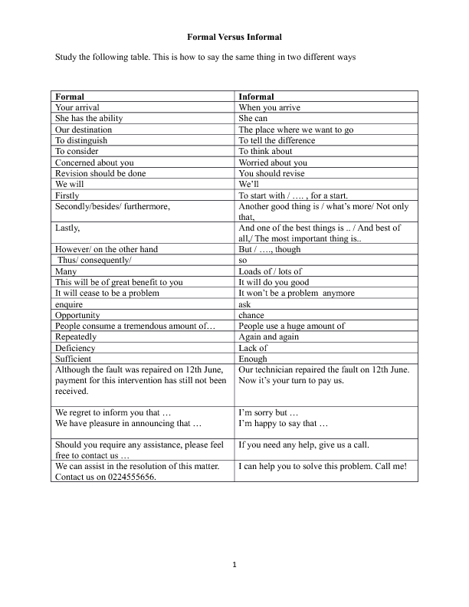

Slide 22
Slang: One form of non-standard language
C’mon! = Come on!
cop = policeman
’cos = because (first recorded in the OED in 1828)
cuppa = cup of tea
don’t = doesn’t – He don’t love me.
dunno = don't know (first recorded in the OED in 1842)
gimme = give me – Gimme my bag!
kinda = kind of
lemme = let me – Lemme see that book!
lil’ = little – He’s gotta nice lil’ house in the country.
lotta = a lot of – He’s gotta lotta money!
ma = mama
OK = all right. Originally a deliberate misspelling of "all correct" (oll korrect).
ol’ = old
yeah = yes
wotcha = What are you ...? – Wotcha gonna do when you get there?

Slide 23
What is a Declarative Sentence?
In English grammar, a declarative sentence is expressed in the form of a statement. Declaratives express an active state of being in the present tense, in contrast to a command (imperative), a question (interrogative), or an
exclamation (exclamatory).

Slide 24
What is an Expressive form of language?
Expressive form of language reports feelings or attitudes of the writer (or speaker), or of the subject, or evokes feelings in the reader (or listener).
Examples:
Sankha felt nervous
Rabin was angry
Raka is quite handsome

Slide 25
Register
In linguistics, one's register is a style or variety of language determined by such factors as social occasion, context, purpose, and audience, also called stylistic variation.

Slide 26
Examples:
King of Spades and Queen of Hearts (Game of Cards)
Heavy rain due to deep depression (Meteorology)
He knows how to predict the bear and bull markets (Stock market)
Huge investment is required for modernizing the plant (Industry)

Slide 27
Collocation refers to how words go together or form fixed relationships.
the fast train the quick train
fast food quick food
a quick shower a fast shower
a quick meal a fast meal

Slide 28
Collocation: adjective and nouns
Joe always wears blue or white or some other bright color.
We had a brief chat about Iraq but didn’t have time to discuss it properly.
Unemployment is a major problem for the government these days.
Improving the health service is another key issue for the UK.

Slide 29
Collocation: Adverbs and adjectives
Ben and Jane are happily married.
You are fully aware that there are serious problems.
George was blissfully unaware that he was in danger.

Slide 30
Collocation: Nouns and verbs
The economy boomed in 2002.
The company has grown and now employs over 30 people.
The company has expanded and now has branches in most major countries.
The four companies merged in 2013.
They launched the product in 1998.
The price increase poses a problem for them.
The internet has created opportunities for his company.

Slide 31
Style:
Styling, a branch of applied linguistics, is the study and interpretation of texts in regard to their linguistic and tonal style.

Slide 32
Five factors that contribute to the style
Phonetic level
Lexical level
Graphological level
Grammatical level
Phonological level

Slide 33
Recommended questions:
A.Questions carrying 10 marks.
Discuss distinctive features of human language.
What is communication? Write a short article on various types of communication?
What is Standard language? What are the features of standard language?
Write a short essay on various types of Register with suitable examples.
Discuss five factors that contribute to the style of a piece of writing.

Slide 34
B. Questions carrying 5 marks.
What do you understand by ‘arbitrariness’ of language? Give examples.
Briefly discuss two non-verbal modes of communication.
Distinguish between Formal and Informal language with suitable examples.
What is a Declarative Sentence? Illustrate with suitable examples.
What is an Expressive form of language? Give suitable examples.
Define Register with suitable examples.
Define “Collocation” and its various types.

